Slide 1




CURRENCY
CONVERTER
presented by : J . Pavan Tej
organization : Micro IT

Slide 2


Abstract
This presentation aims to provide an overview of a Currency Converter application, highlighting its functionality, benefits, and the technology behind it. Currency converters are essential tools for individuals and businesses engaged in international transactions, travel, or investment. By understanding how a currency converter works, users can make informed decisions regarding currency exchange rates and conversions.

Slide 3

Introduction to Currency Converter
Definition: A Currency Converter is a tool that allows users to convert one currency into another based on current exchange rates.
Importance: Facilitates international trade, travel, and investment by providing real-time currency exchange information.

Slide 4

Key Features
Real-time Exchange Rates: Access to live data from financial markets.
Multiple Currencies: Support for a wide range of global currencies.
User-Friendly Interface: Simple design for easy navigation and quick conversions.
Historical Data: Ability to view past exchange rates for better decision-making.

Slide 5
How It Works
Data Sources: Currency converters pull data from financial institutions and forex markets.
User Input: Users enter the amount and select the currencies to convert.

Slide 6

Benefits of Using a Currency Converter
Accuracy: Provides up-to-date and precise exchange rates.
Convenience: Easily accessible via web or mobile applications.
Cost-Effective: Helps users avoid unfavorable exchange rates and fees

Slide 7

Use Cases
Travelers: Calculate expenses in foreign currencies before and during trips.
Businesses: Manage international transactions and pricing strategies.
Investors: Analyze currency trends for investment opportunities.

Slide 8

Technology Behind Currency Converters
APIs: Integration with financial data APIs for real-time updates.
Responsive Design: Ensures usability across devices (desktop, tablet, mobile).
Security: Implementation of secure protocols to protect user data.

Slide 9
HTML Code
<!DOCTYPE html>
<html>
<head>...</head>
<body>
<div class="container">
<div class="header">...</div>
<div class="form">...</div>
<div class="result">...</div>
<div class="footer">Created by J. Pavan Tej</div>
</div>
</body>
</html>

Slide 10
css code
body {
background: #eef3fd;
font-family: "Segoe UI", sans-serif;
}
.container {
background: white;
padding: 30px;
border-radius: 15px;
box-shadow: 0 10px 30px rgba(0,0,0,0.1);
}
.header {
background: #2c6fff;
color: white;
border-radius: 10px 10px 0 0;
}

Slide 11
Java Script code
const convert = async () => {
const amount = document.querySelector('input').value;
const from = document.querySelectorAll('select')[0].value;
const to = document.querySelectorAll('select')[1].value;
const res = await fetch(`https://api.exchangerate-api.com/v4/latest/${from}`);
const data = await res.json();
const rate = data.rates[to];
const result = (amount * rate).toFixed(2);
document.querySelector('.to-value').innerText = `${result} ${to}`;
};

Slide 12
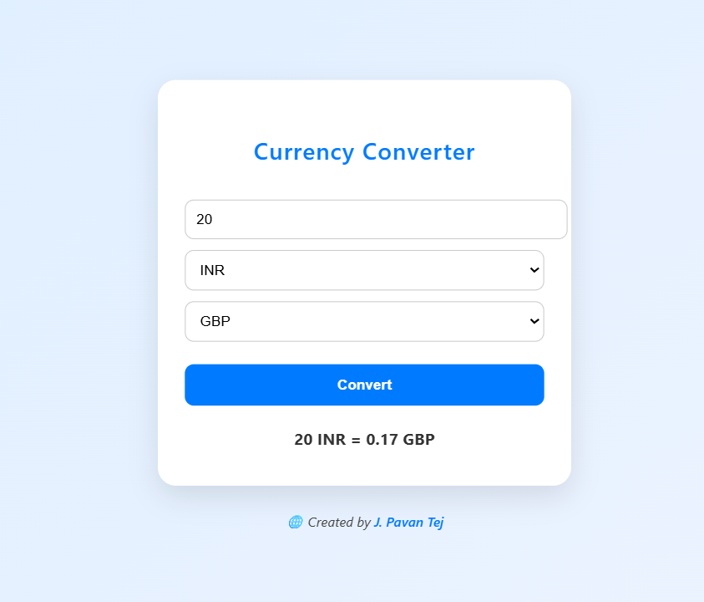

Slide 13


SALFORD & CO.
Conclusion
Currency converters are vital tools in today’s global economy, enabling users to make informed financial decisions. With real-time data, user-friendly interfaces, and a variety of features, they serve as essential resources for anyone dealing with multiple currencies.

Slide 14
Thank You

